Slide 1

Customer Sentiment Analysis: British Airways
Data Collection, Cleaning, and Insights
Presented by Deekshithaa Y M

Slide 2

Objective
• Understand customer sentiment using online reviews.
• Use Python to scrape, clean, analyze, and visualize.
• Help British Airways identify strengths & pain points.

Slide 3
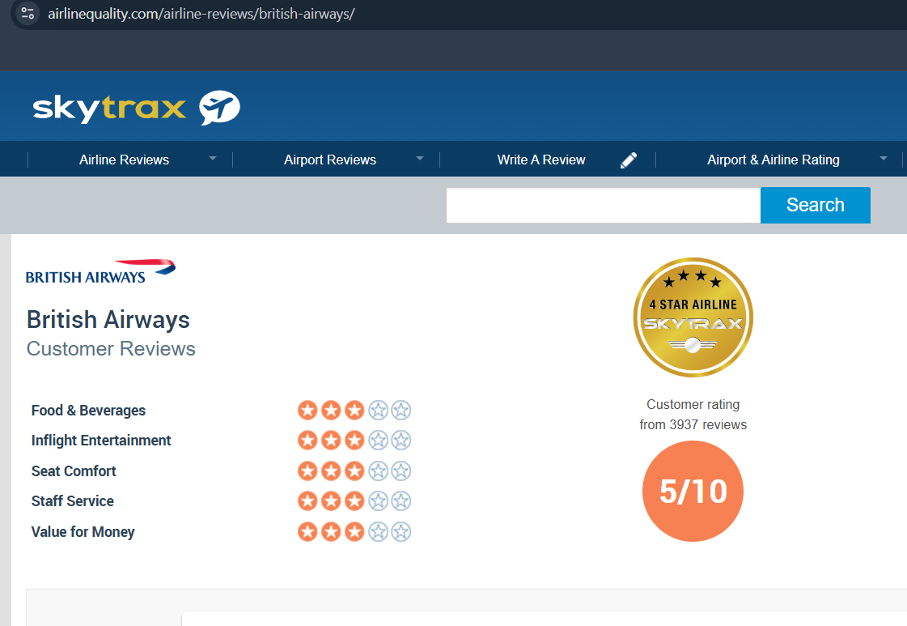
Where Did I Get the Data?
Website Name: Skytrax
URL: https://www.airlinequality.com/airline-reviews/british-airways/
Web scraping used with requests and BeautifulSoup
Extracted review text, rating, and review dates

Slide 4
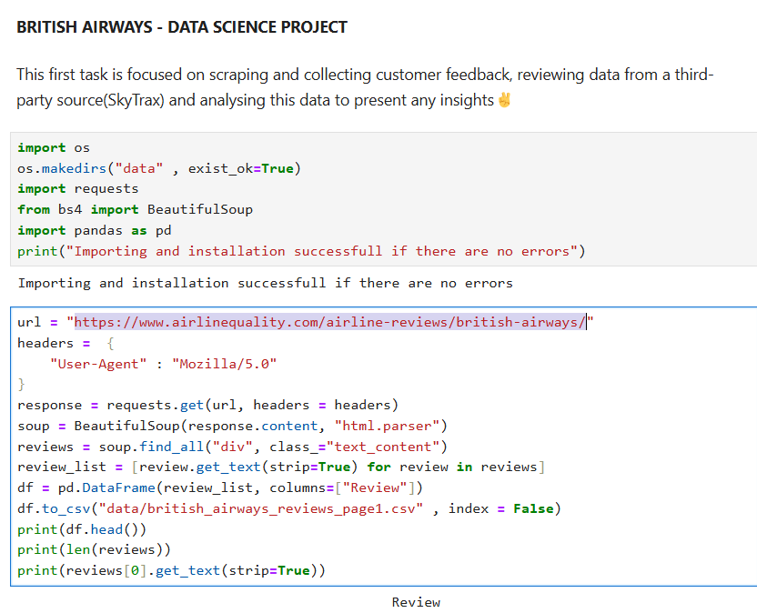
How I Prepared the Data
Removed empty rows, duplicates, non-English text
Converted dates to datetime format
Cleaned text (lowercased, removed stopwords & punctuation)

Slide 5
How I Measured Sentiment
Used TextBlob to classify sentiment
Categories: Positive, Negative, Neutral
Based on polarity score of each review
Green bar = Happy reviews
Red bar = Angry reviews
Gray bar = Meh reviews

Slide 6
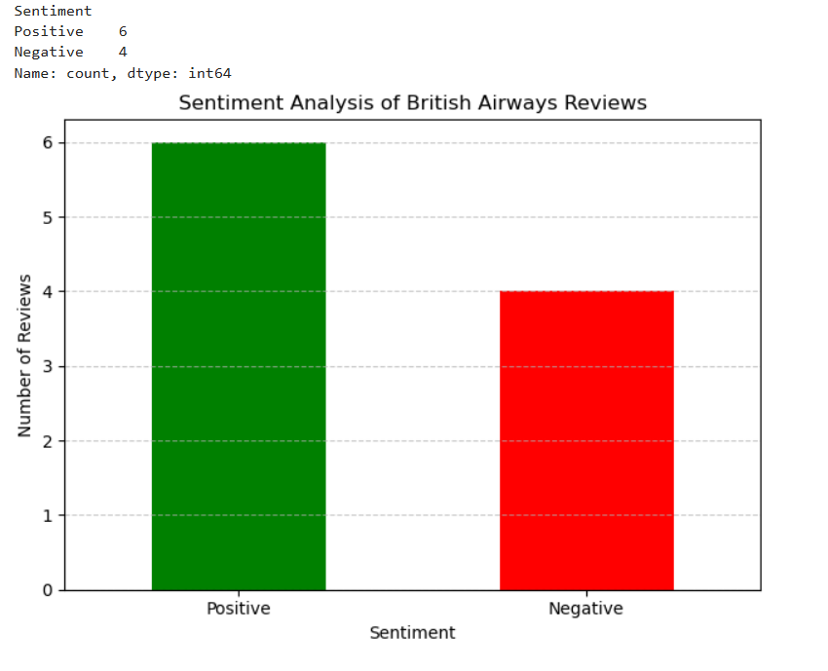

Slide 7
What Customers Feel Overall
Bar chart: Positive vs Negative vs Neutral as shown previously
Majority of reviews are positive
Key Insight: British Airways has a good reputation, but some more issues to be sorted out – to make it to the goal of 100% satisfaction!
Current Status lies at 60% positive reviews

Slide 8
What People Talk About
Word frequencies after cleaning
Top keywords: flight, ba, staff, verified
Shown using a word cloud in the next slide
Top 10 words extracted from reviews with frequencies👇🏻👇🏻

Slide 9
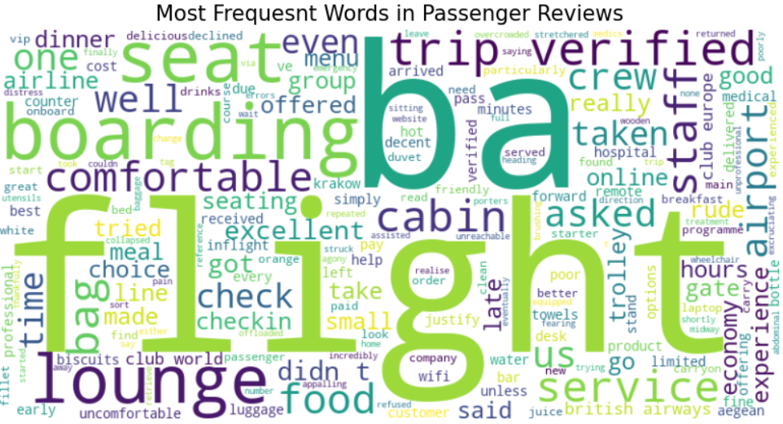

Slide 10
Examples of Each Sentiment
Positive: “Staff were amazing and helpful.”
Negative: “Worst flight experience ever!”
Neutral: “The flight was okay, nothing special.”
TextBlob reads the sentence and gives a score:
+1.0 = very happy
0 = neutral
-1.0 = very angry
We check that score:
If it’s above 0 → call it Positive
If it’s below 0 → Negative
If exactly 0 → Neutral

Slide 11
What British Airways Should Do
Customers love: staff, check-in
Complaints: delays, food, baggage
Suggestions:
Improve punctuality
Staff training
Better communication

Slide 12
Thanks!
Presented by Deekshithaa Y M

